Slide 1
Chapter 7 Single-Dimensional Arrays

Slide 2
Random shuffling

Slide 3
Problem: Deck of Cards
The problem is to write a program that picks four cards randomly from a deck of 52 cards. All the cards can be represented using an array named deck, filled with initial values 0 to 51, as follows:
int[] deck = new int[52];
// Initialize cards
for (int i = 0; i < deck.length; i++)
deck[i] = i;
DeckOfCards
Run

Slide 4
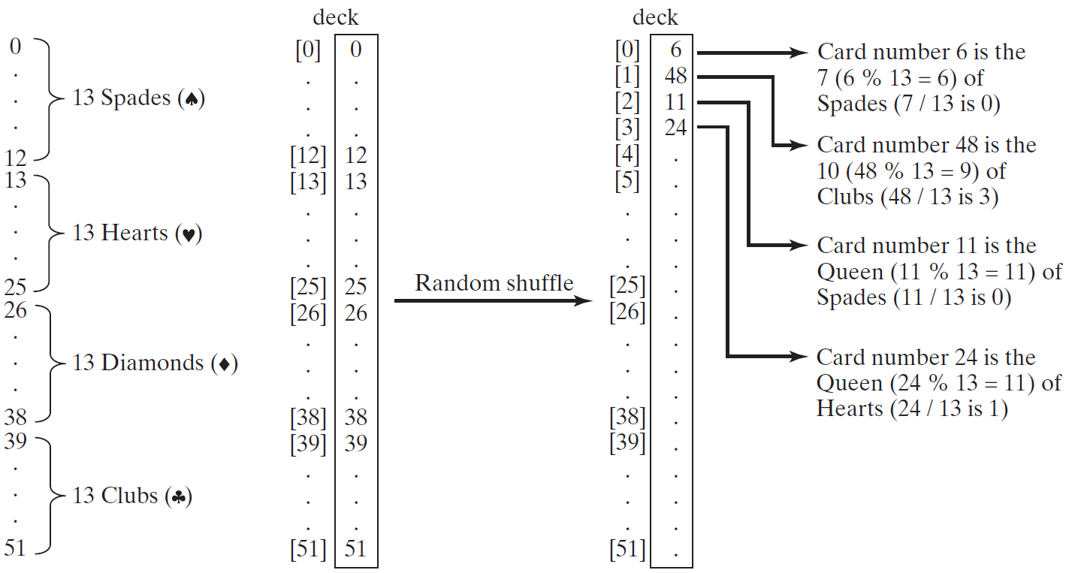
Problem: Deck of Cards, cont.

Slide 5
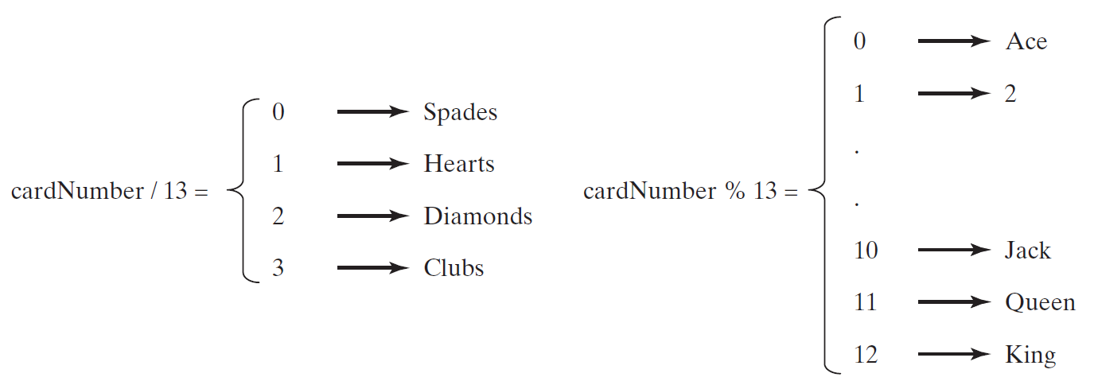
Problem: Deck of Cards, cont.
GUI Demo (picking four cards)
DeckOfCards
Run

Slide 6
DeckOfCards.java
Page 259 Listing 7.2

Slide 7
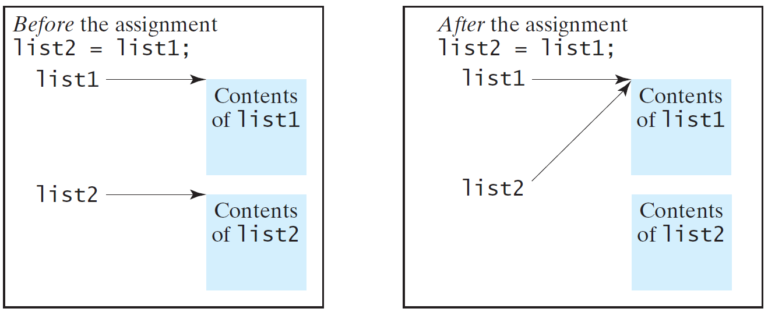
Copying Arrays
Often, in a program, you need to duplicate an array or a part of an array. In such cases you could attempt to use the assignment statement (=), as follows:
list2 = list1;

Slide 8
Copying Arrays
Using a loop:
int[] sourceArray = {2, 3, 1, 5, 10};
int[] targetArray = new int[sourceArray.length];
for (int i = 0; i < sourceArrays.length; i++)
targetArray[i] = sourceArray[i];

Slide 9
The arraycopy Utility
arraycopy(sourceArray, src_pos, targetArray, tar_pos, length);
Example:
System.arraycopy(sourceArray, 0, targetArray, 0, sourceArray.length);

Slide 10
Passing Arrays to Methods
public static void printArray(int[] array) {
for (int i = 0; i < array.length; i++) {
System.out.print(array[i] + " ");
}
}
Invoke the method
int[] list = {3, 1, 2, 6, 4, 2};
printArray(list);
Invoke the method
printArray(new int[]{3, 1, 2, 6, 4, 2});
Anonymous array

Slide 11
TestPassArray.java
Page 263 Listing 7.3

Slide 12
Pass By Value
Java uses pass by value to pass arguments to a method. There are important differences between passing a value of variables of primitive data types and passing arrays.
For a parameter of a primitive type value, the actual value is passed. Changing the value of the local parameter inside the method does not affect the value of the variable outside the method.
For a parameter of an array type, the value of the parameter contains a reference to an array; this reference is passed to the method. Any changes to the array that occur inside the method body will affect the original array that was passed as the argument.

